Slide 1
Notes on a Holistic Framework for Teaching, Learning, Agency, Healthy Development & School Success
Compiled by Hal A. Lawson
December 2015

Slide 2
Resources Used
Ferguson et al Harvard Achievement Gap Report on Teaching for Agency and Engagement
http://www.agi.harvard.edu/projects/TeachingandAgency.pdf
Roderick et al CCSR Consortium Report on non-cognitive factors and learning/achievement
https://consortium.uchicago.edu/sites/default/files/publications/Noncognitive%20Report.pdf
Foundations for Young Adult Success: A Developmental Framework CCSR
http://www.wallacefoundation.org/knowledge-center/after-school/key-research/Documents/Foundations-for-Young-Adult-Success.pdf
Investing to Improve the Well Being of Vulnerable Young Adults
http://www.ytfg.org/2015/11/investing-to-improve-the-well-being-of-vulnerable-youth-and-young-adults-recommendations-for-policy-and-practice/
Social and Emotional Learning Policy Brief 2015
http://www.ascd.org/ASCD/pdf/siteASCD/policy/SEL_PolicyBrief_Final_11-16-15.pdf

Slide 3
Chicago Consortium Operational Frame for Holistic Development

Slide 4
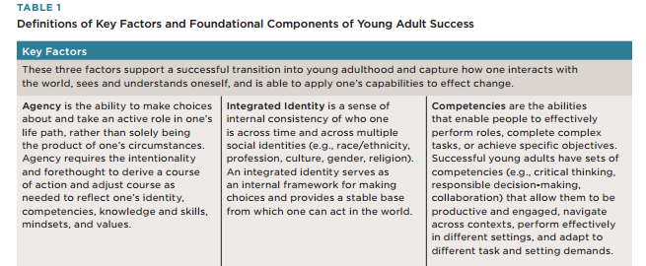

Slide 5
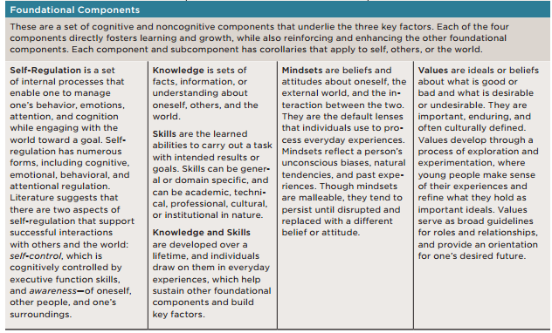

Slide 6
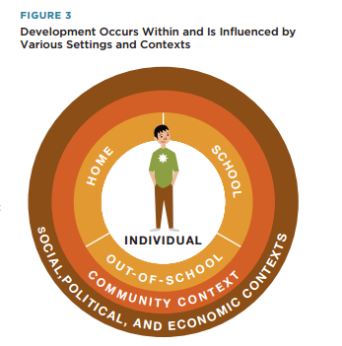

Slide 7
An Inter-school Progression for Development

Slide 8
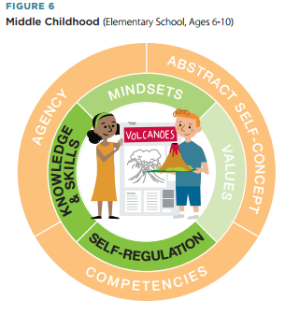

Slide 9
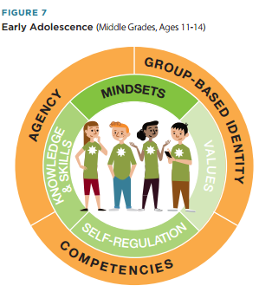

Slide 10
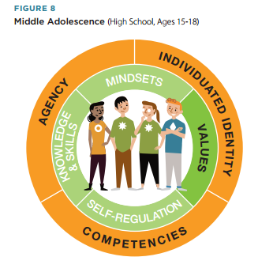

Slide 11
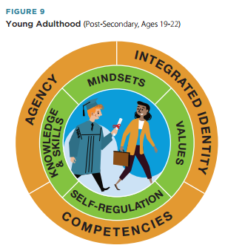

Slide 12
Deweyian Teaching & Learning

Slide 13
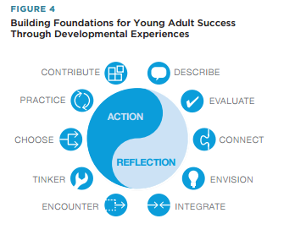

Slide 14
Bigger Picture for Vulnerable Kids

Slide 15
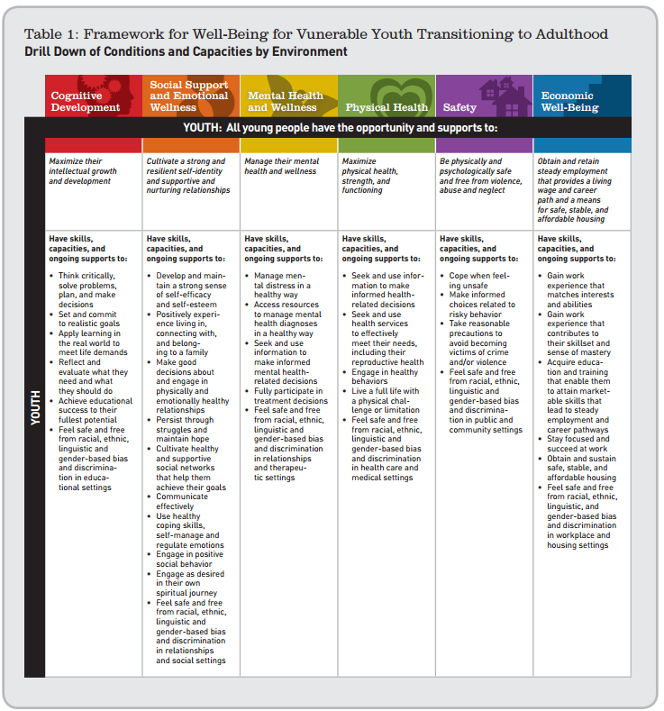

Slide 16
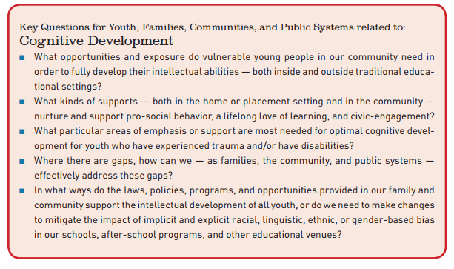

Slide 17
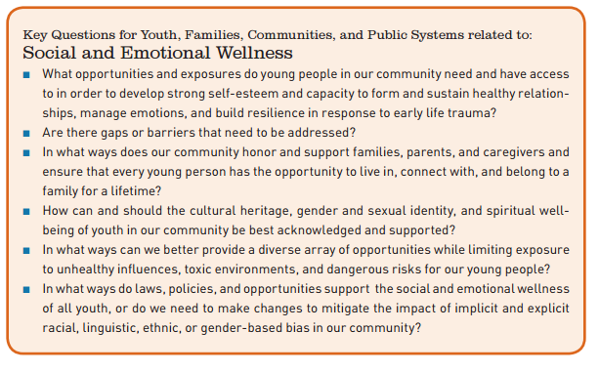

Slide 18
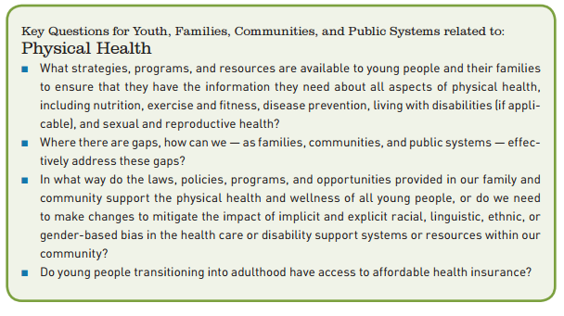

Slide 19
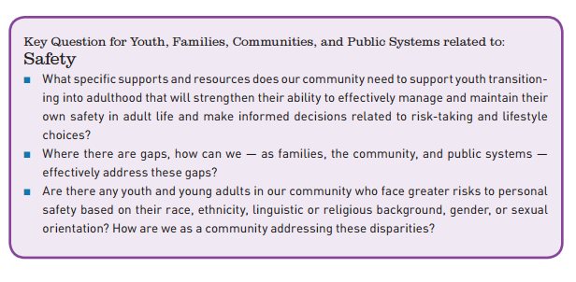

Slide 20
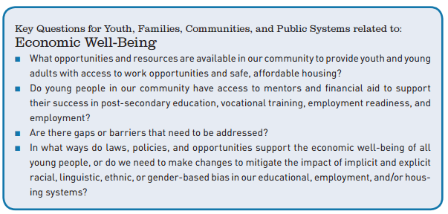

Slide 22
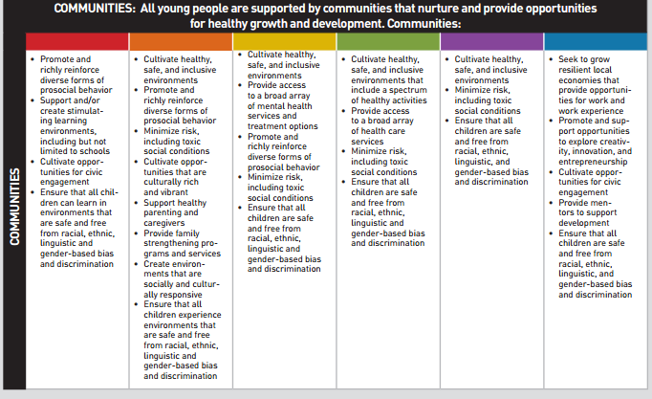

Slide 23
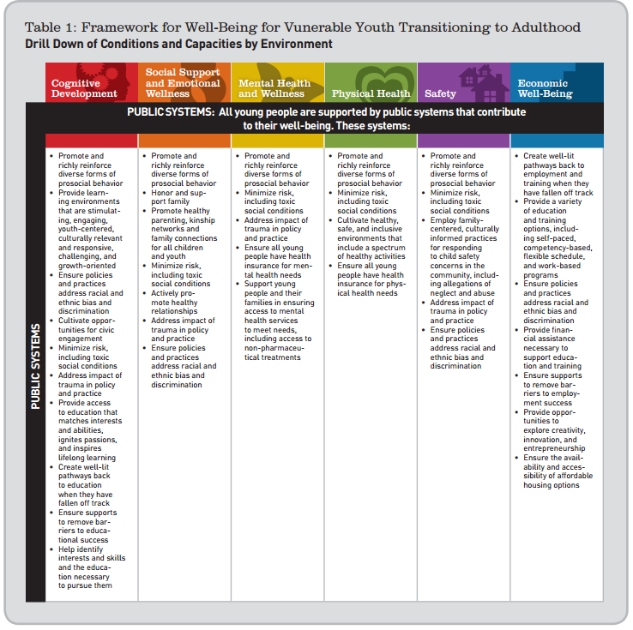

Slide 24
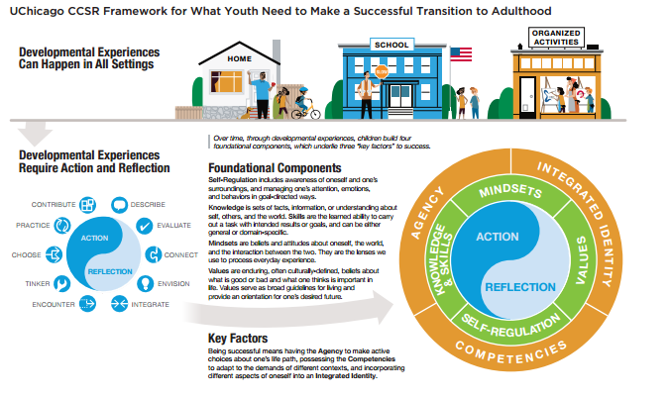

Slide 25
The Conventional Frame: SEL for Educators and Schools

Slide 26
Conventional Frame for SEL 2

Slide 27
Roderick et al Non-cognitive Factors Matter

Slide 28
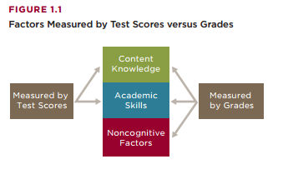

Slide 29
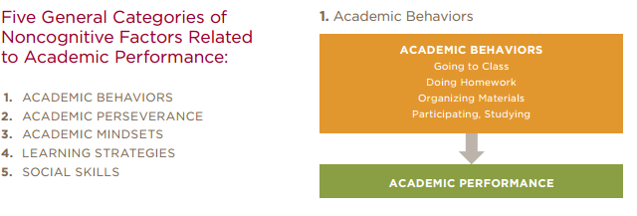

Slide 30
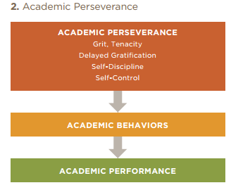

Slide 31
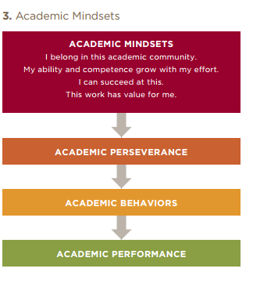

Slide 32
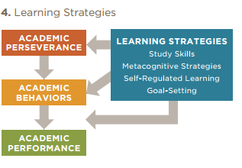

Slide 33
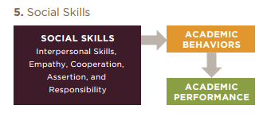

Slide 34
Ferguson et al: Taking It to Classrooms & Teaching/Learning

Slide 35
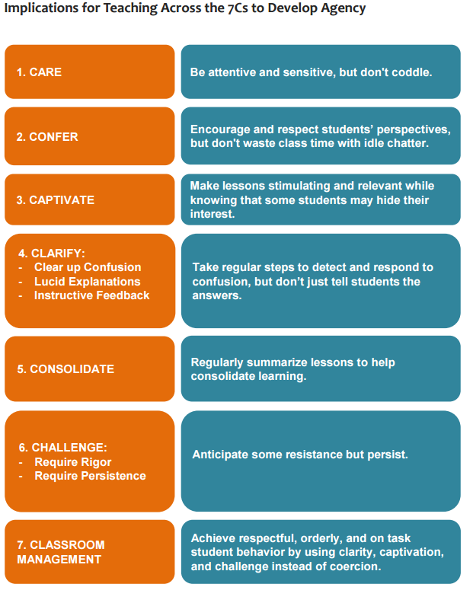

Slide 36
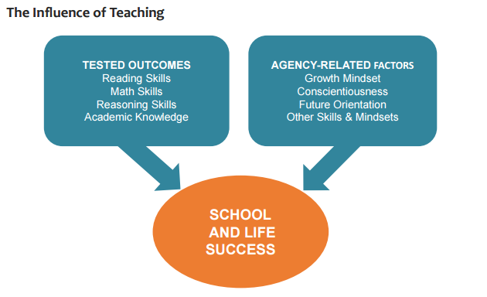

Slide 37
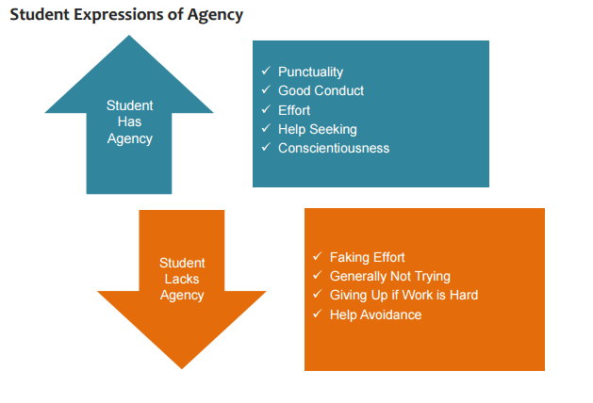

Slide 38
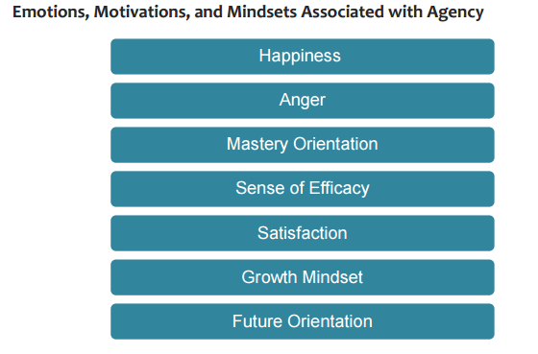

Slide 39
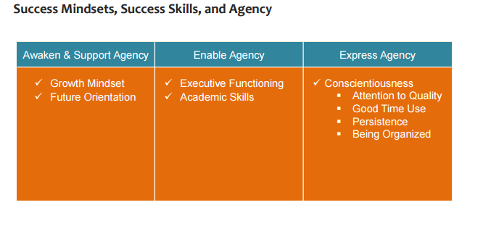

Slide 40
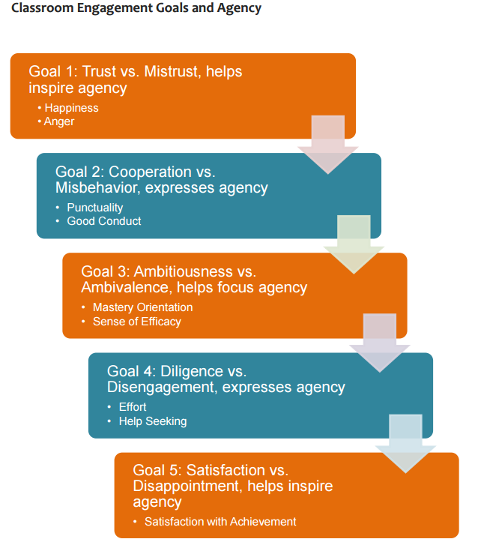

Slide 41
Teacher and Student Indicators

Slide 42
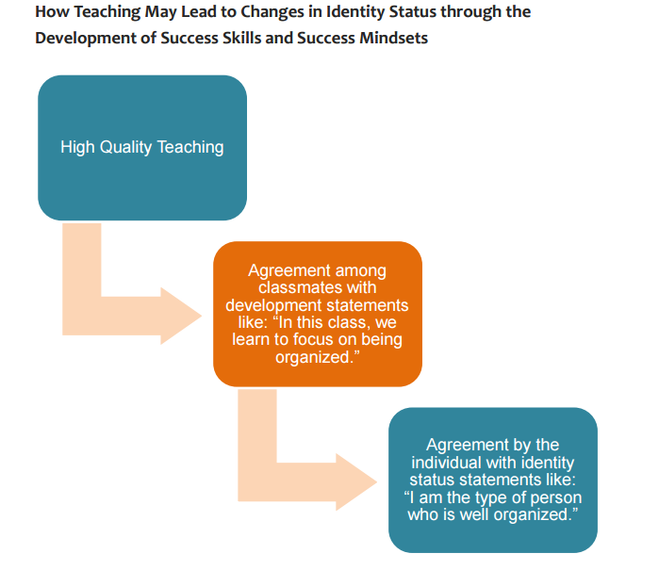

Slide 43
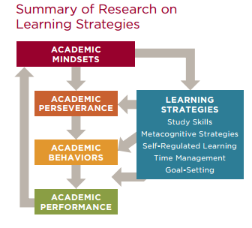

Slide 44
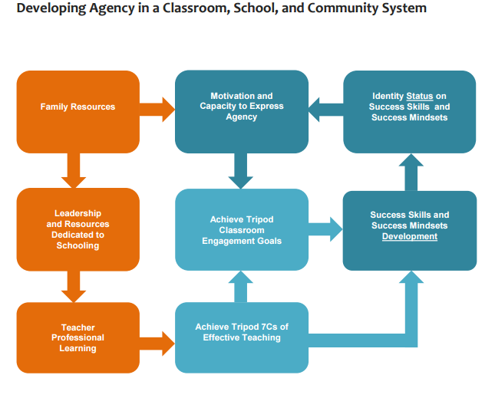

Slide 45
OECD Innovation Pumps

